Slide 1




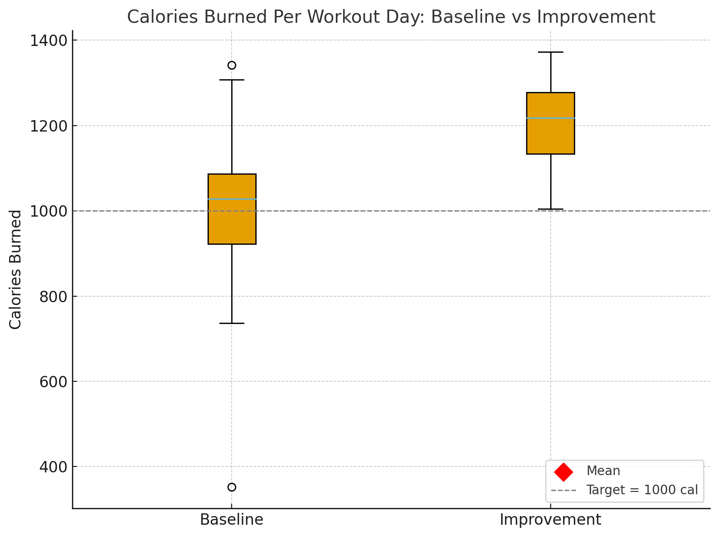
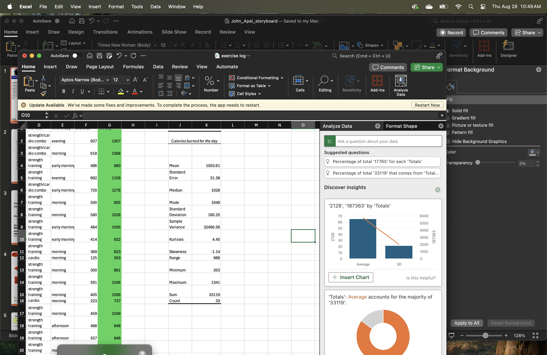
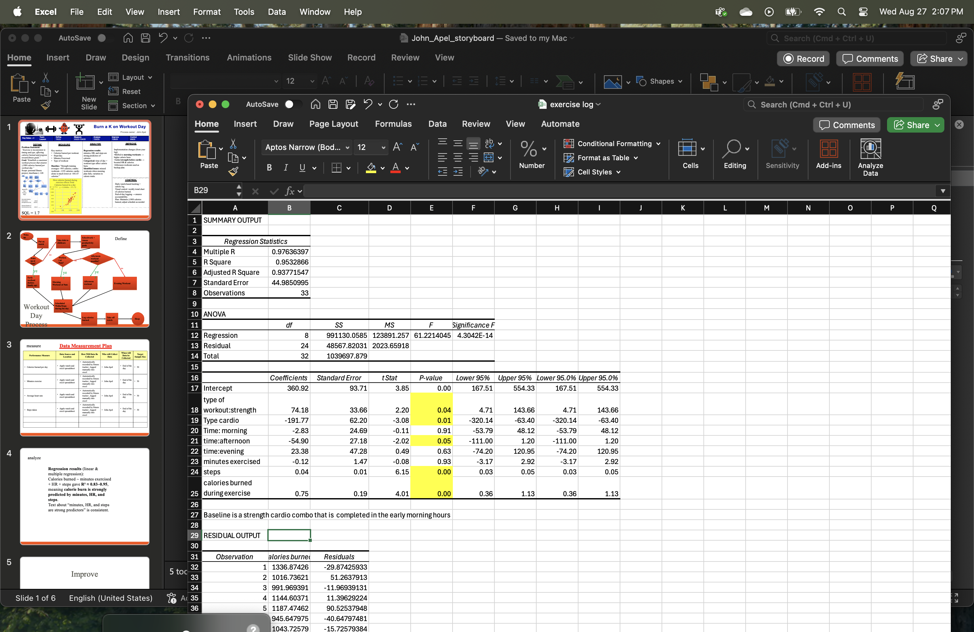
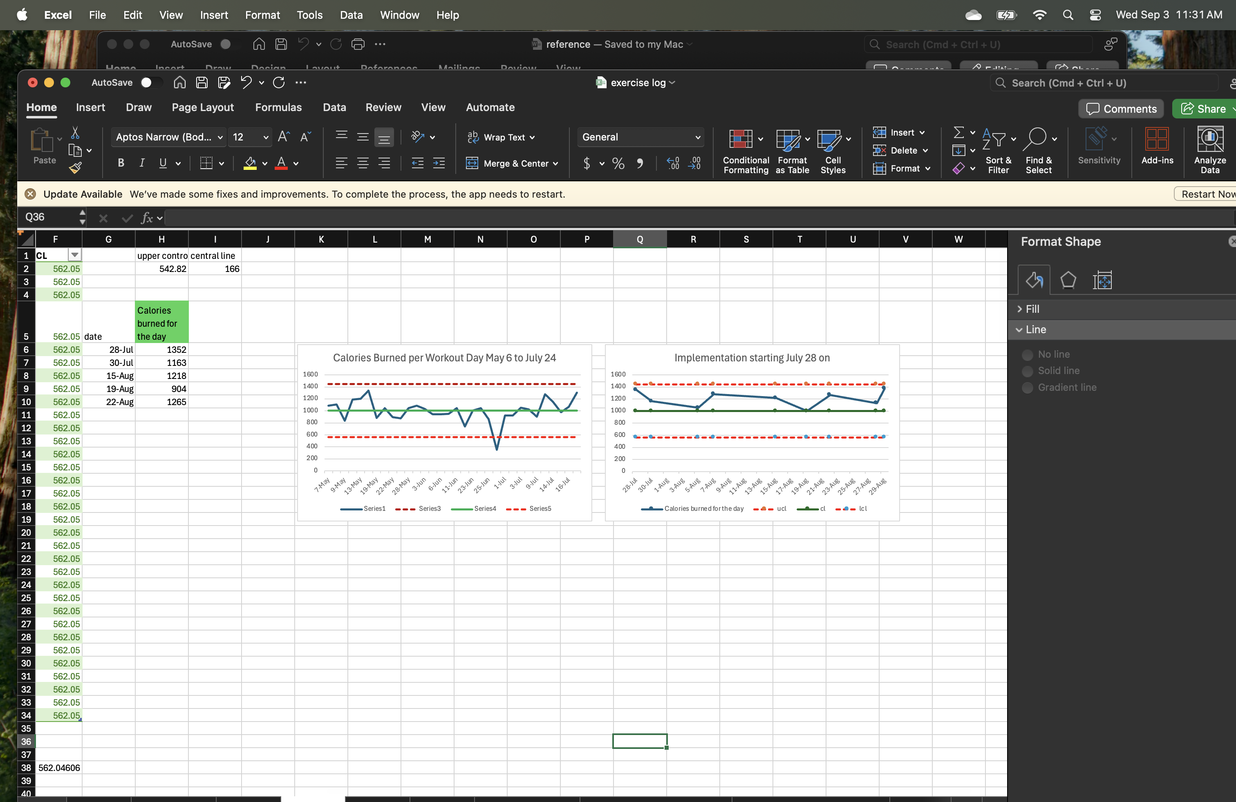
Burn a K on Workout Day
Process owner: John Apel
Key Dates --->
Team
Launch
Define
7/6/25
Measure
5/6/25-7/24/25
Analyze
7/25/25
Improve
7/28/25
Control
9/8/25
(Hₐ): μ₁ > μ₀ Reject Null
SQL = 1.7
DEFINE
MEASURE
ANALYZE
IMPROVE
Regression results: strength workout and combo workout burn more than cardio. Early morning burns more than afternoon. Cals per workout and steps are strong predictors of calories.
Identified issues: missed workouts when morning plan fails, variation in calorie totals.
The current process contains too many decision points and opportunities for defects
Key metrics:
Calories burned per workout.
Steps/day.
Minutes Exercised
Type of workout
Time of Day Baseline: ”Strength training averages ~993 calories per day; combo workouts ~1193 calories; cardio alone is much lower at ~641.67 calories.”
statistically significant (p = 0.0006)
Want to increase the mean
+200 calorie improvement
CONTROL
Trend shows consistent achievement of 1000+ calorie days after switching to 5:15am strength or combo workouts. Step count supplements calorie burn during recovery phase
2*SD less than the mean = 643.11 cals for the day. That lower bound is too low for my goals!
Problem Statement: “Exercise is inconsistent in timing and type, affecting calories burned and progress toward fitness goals.”
Goal:“Establish a consistent workout process that ensures ≥1000 calories burned per workout day.”
Scope: personal fitness project, timeframe (~120 days).
Zero defects in 9 workout days, need more samples for greater confirmation
Notes:
5 tools present. Insights present

Slide 2
Define
My dad worked out every day of his life until he was no longer physically able. His dedication instilled in me a deep belief in the importance of exercise. The discipline he cultivated allowed him to achieve impressive feats, and he always said, “Never half step. If you’re going to do something, do it to the fullest extent.”
I watched him work out through the grief of losing my mom to cancer. I watched him work out through the onset of Parkinson’s, because his doctor told him it was the best way to fight what was coming. Now, as I live my life without my parents, I work out to build longevity for my two daughters. When I train, I never half step — I give it everything. If I am putting in that effort, I want to burn at least 1,000 calories each day.
Beyond inspiration, health became my call to action. After years in the restaurant industry, I faced high triglycerides, high blood pressure, and excess weight. Through this journey, I have been able to lower my triglycerides, bring my blood pressure back to a healthy range, and lose weight.

Slide 3
Define
Operational Definitions
Workout Type – calories calculated by apple watch(cardio) and fitbod app(strength)
Cardio – Jogging , walking on hills, rowing, or biking for 30 minutes
Strength- weightlifting for 60 minutes
Strength and Cardio Combo – 20 minutes cardio and 60 minutes weightlifting
Time of day - has NOT been strategic, more at the whim of personal and family schedule
Early morning (5:15am)
Morning (9 am)
Afternoon (12-2)
Evening (after 6 pm)
Steps – walking steps tracked with apple watch
Minutes Exercised – minutes logged on apple watch starting by initiating specific exercise through fitness application (cardio) or fitbod application (strength) until workout is manually stopped in the applications
Calories Burned during exercised – Calorie burn calculated by fitbod and fitness app that are recorded during the exercise
Calories burned for the entire day – Calorie burn number recorded for the entire time the apple watch was worn (wake up to bed time). This is the target that I want to predict. The goal is that any day I am exercising, I will burn a total of at least 1000 calories for the day.

Slide 4
Workout Day Process Map
Wake up
Define
The current process contains too many decision points and opportunities to procrastinate or skip exercise.
Workout timing is overly influenced by external factors (family schedule, daily obligations, unexpected events).
Take kids to childcare
Schoolwork + Assess productivity goals
Put on watch
no
Afternoon workout possible?
Up at 5am?
Workout at 9am?
no
yes
yes
yes
no
Early workout
(before family up)
Morning Workout at 9am
Afternoon workout
Evening Workout
Walks to get Steps during the day
Log calories burned
Take off watch
Sleep

Slide 5
Data Measurement Plan
Measure
Performance Measure | Data Source and Location | How Will Data Be Collected | Who will Collect Data | When will Data be Collected | Target Sample Size
Calories Burned per Day (target) | Apple watch | Recorded by fitness tracker , logged manually into excel | John Apel | End of the day | 30
Minutes Exercised | Apple watch | Recorded by fitness tracker , logged manually into excel | John Apel | End of the day | 30
Calories Burned During Exercise | Fitbod App | Recorded by fitness tracker , logged manually into excel | John Apel | End of the day | 30
Steps | Apple watch | Recorded by fitness tracker , logged manually into excel | John Apel | End of the day | 30
Type of Exercise | Fitbod App | Recorded by fitness tracker , logged manually into excel | John Apel | End of the day | 30
Time of day | Dictated by daily itinerary | Recorded by fitness tracker , logged manually into excel | John Apel | End of the day | 30
Notes:
Speak to decision for alpha level and sample size . What about measurement error?

Slide 6
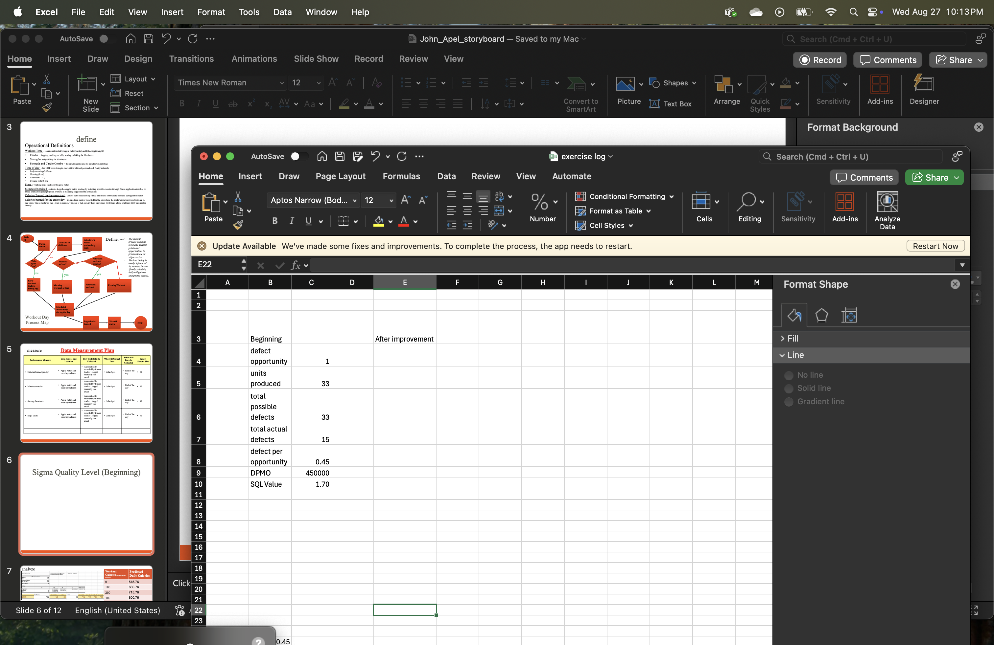
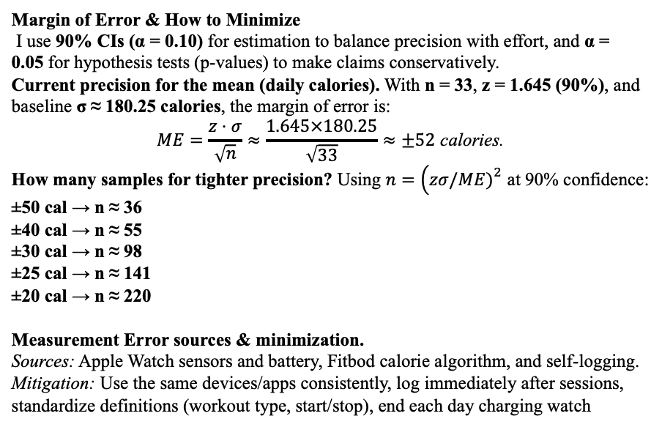
Sigma Quality Level
Measure
Data is a mix of discrete (steps, workout type, time of day) and continuous (minutes exercised, calories/workout, calories/day)
Ideal sample size for t-test is 30 or more (I have 33)
For improvement phase, I have a sample of 9 which may be ok for proof of concept, but I would want more samples to strengthen conclusion
Margin of Error & How to Minimize
I use 90% CIs (α = 0.10) for estimation to balance precision with effort, and α = 0.05 for hypothesis tests (p-values) to make claims conservatively.
Current precision for the mean (daily calories). With n = 33, z = 1.645 (90%), and baseline σ ≈ 180.25 calories, the margin of error is:
$$ME=\frac{z⋅σ}{\sqrt{n}}≈\frac{1.645×180.25}{\sqrt{33}}≈±52 \text{calories}\text{.}$$
How many samples for tighter precision? Using $n=\left(zσ/ME{\left.)\right.}^{2}\right.$ at 90% confidence:
±50 cal → n ≈ 36
±40 cal → n ≈ 55
±30 cal → n ≈ 98
±25 cal → n ≈ 141
±20 cal → n ≈ 220
Measurement Error sources & minimization.
Sources: Apple Watch sensors and battery, Fitbod calorie algorithm, and self-logging.
Mitigation: Use the same devices/apps consistently, log immediately after sessions, standardize definitions (workout type, start/stop), end each day charging watch
*I plan to continue gathering data and reevaluating the value of SQL beyond the scope of this project. Reducing ME is also appealing, as it suggests a more consistent and streamlined process. Such consistency can complement nutritional planning and enhance the overall health journey.

Slide 7
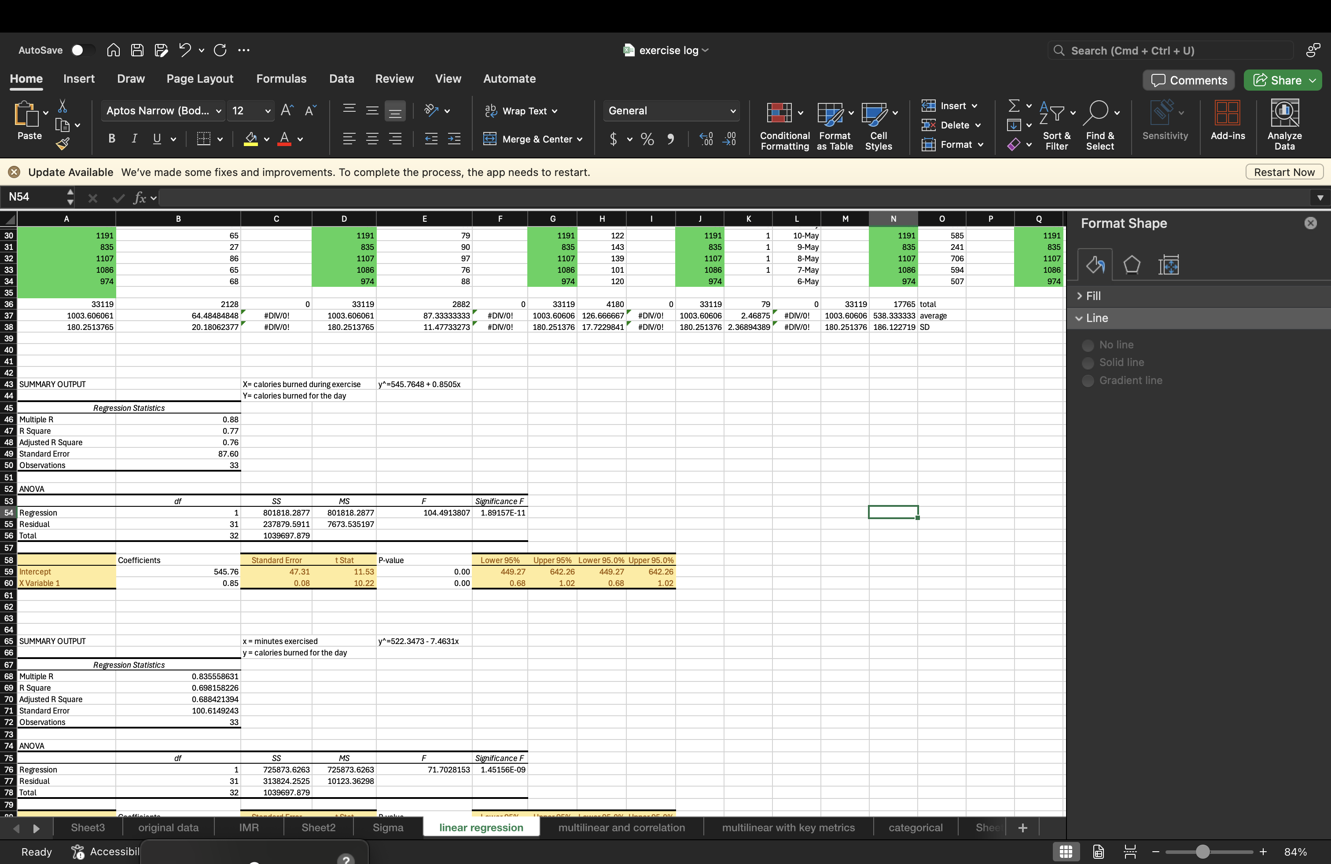
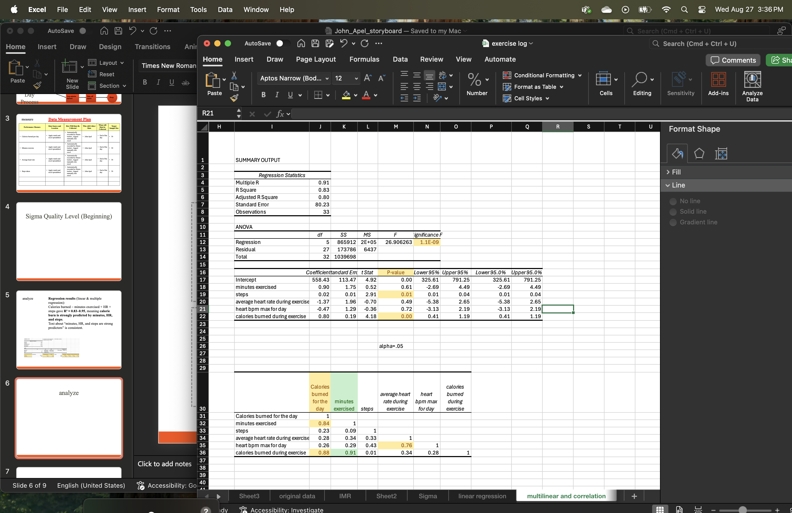
Analyze
The linear regression model predicts that on a non-workout day I will burn 545.76 calories (intercept)
For every 1 calorie burned during a workout, total daily burn goes up by +0.85 calories (slope).
Example: If I burn 600 workout calories, then daily burn increases by about 600 × 0.85 ≈ 510 calories, on top of the 545 baseline.
Predicted daily total = 545.76 + (0.85 × 600) ≈ 1,056 calories. *Goal Met*
Workout Calories (burned during exercise) | Predicted Daily Calories
0 | 545.76
100 | 630.76
200 | 715.76
300 | 800.76
400 | 885.76
500 | 970.76
600 | 1055.76
700 | 1140.76
Correlation Takeaways
Workout duration + exercise calories = best predictors of daily calorie burn.
Steps add value but are secondary compared to workout factors.
Heart rate metrics are moderately correlated with total burn, reflecting exercise intensity but not as direct as time and calories. (I was looking to tie heart rate to cardio, after injuring knee, I did not attempt cardio or pursue this connection.)

Slide 8
Analyze
Summary of Findings from Multilinear Regression with Key Metrics– Factors Affecting Daily Calories Burned
I analyzed 33 workouts to see how workout type, time of day, steps, and workout calories affect total daily calories burned. The model explained about 95% of the variation in daily calorie burn (R squared= 0.953), meaning our predictors were very effective at capturing what drives calorie expenditure.
1. Workout type makes the biggest difference
Cardio workouts burned ~192 fewer calories per day than combo workouts, all else equal.
Strength workouts burned ~74 more calories per day than combo workouts.
Conclusion: Cardio is least effective for total daily calorie burn in this dataset, while strength and combo workouts are better.
2. Steps matter
Each extra step added 0.039 calories to the day — roughly +39 calories for every 1,000 steps.
3. Calories burned during exercise are a strong driver
Each calorie burned during the workout added 0.75 calories to the daily total.
This shows that exercise sessions significantly contribute to total daily burn beyond other factors.
4. Time of day matters only a little
Afternoon workouts burned ~55 fewer calories than early morning workouts.
Morning and evening workouts showed no meaningful difference from early morning in this dataset based on p-value.
5. Practical implications
To maximize daily calorie burn:
Favor strength or combo workouts over cardio.
Increase step count — even small increases add up.
Push for higher workout calorie burn, as it has a clear link to daily totals.
Time of day is less important, though afternoon workouts might have a slight disadvantage.

Slide 9
Improve
Get up at 5 am
Charge watch. go to bed
Put on apple watch
Workout
~ 5:15 am
Walk throughout day
Log data at end of day
Morning Workouts lead to greater number of calories burned for the entire day
Morning Workouts do not interrupt productivity, childcare, and family needs throughout the rest of the day
A combination of Strength and Cardio workout averages the highest calorie burn for the day. This type of workout paired with a 5 am start will maximize calories burned.
Caveat – I injured my knee which made it painful and unsafe to do cardio workouts – The solution was early morning strength workouts , and as recovery allowed walking through the day. Aiming for 8,000 to 10,000 steps will compensate for the loss of cardio exercise (10,000 steps = ~390 calories on workout days).
When fully recovered I will implement a combination of cardio and strength workouts with a 5:15 am start time.

Slide 10
Improve – Hypothesis Test Results
Null (H₀): μ₁ ≤ μ₀
Alternative (Hₐ): μ₁ > μ₀
μ₀ = mean daily calories burned under the old process (baseline)
μ₁ = mean daily calories burned under the new process (after intervention)
Results of a one-tailed two-sample t-test comparing baseline vs improvement calorie burns.
Conclusion: Early morning + structured workouts significantly increased daily calorie burn
Baseline mean: 1004 cal/day
Improvement mean: 1205 cal/day
One-tailed t-test: t = 3.82, p = 0.0006 → statistically significant
Since p < 0.05, I reject H₀.
Evidence strongly supports that the new process burns significantly more calories than your baseline.
On average, the improvement raised daily calorie burn by about +200 calories per workout day.

Slide 11
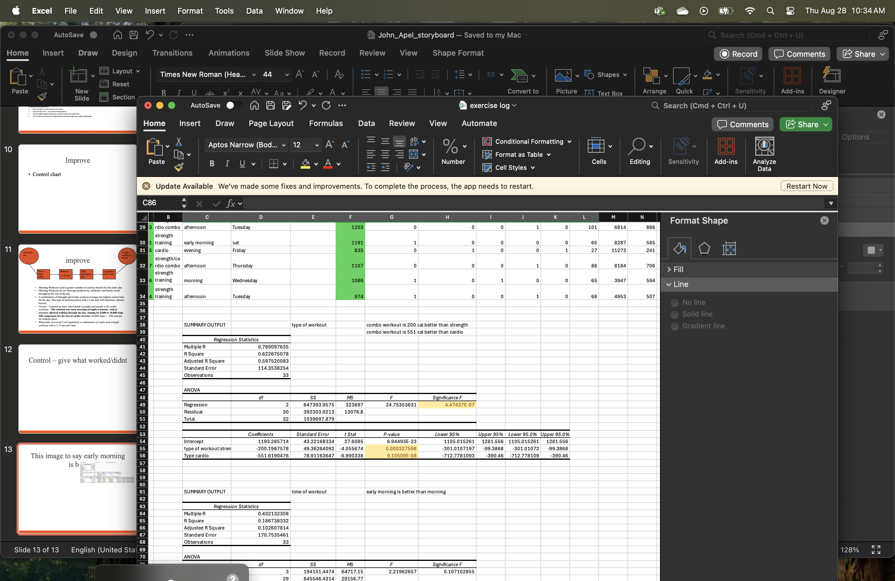
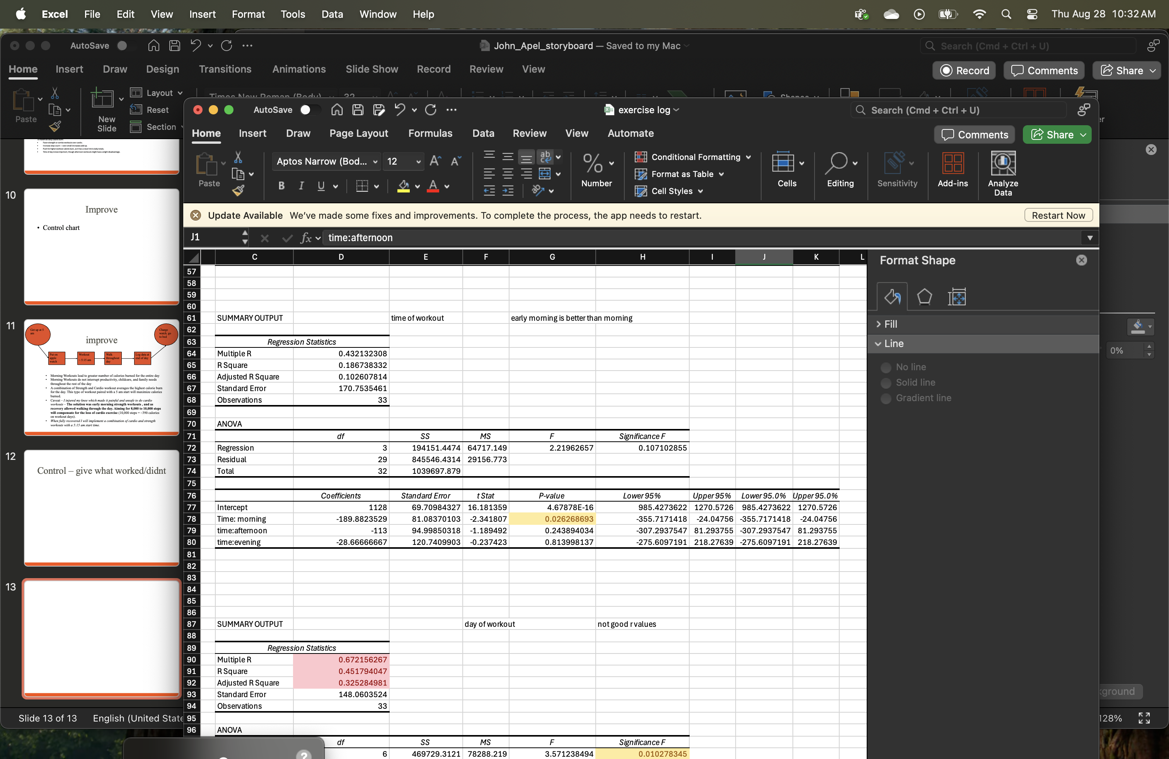
Control – Moving Forward
Lessons Learned
Early Morning workouts lead to higher daily burn and fewer disruptions
Combo workouts (strength + cardio) are most effective
Even small step increases have big calorie impact (~390 cal from 10k steps)
Skipping the workout early in the day often leads to no workout at all
Injuries require flexibility in the plan—but walking still works
What’s Next?
Resume combo workouts once knee fully healed
Continue early morning habit to protect workout time
Add habit-tracking or alarms to reinforce control phase
Use data insights to build next goal (e.g. strength goal, weight loss goal, improve cardio health goal)
Model shows strength and cardio combo workout to burn the most calories. When healed from knee Injury, combo workouts will continue!
5am workout is intercept. The model shows it to be better than morning (9am) workouts. Additional models showed afternoon and evening to burn less daily calories than 5am workouts.

Slide 12
Control – Sustaining 1k-Calorie Days
Daily Tracking System Maintained
Apple Watch tracks steps and calories
Fitbod logs strength workouts
Fitness app logs cardio
End-of-day logging for accountability
Visual Controls
Apple Fitness Goal level set to 1000 to so the ring visual can give quick view of current status
Apple watch Reminders to move (steps) throughout the day
Control Plan
Maintain 5:00am wake-up & 5:15am workout routine
Prioritize combo workouts when fully recovered
Daily walks to maintain ≥8,000–10,000 steps
Adjust workout timing only if early workout is missed
Response Plan if Target Missed
Missed morning? Default to strength-only at next available time
Below target calories? Add a brisk walk in evening
Daily and Weekly review
In 9 observed improvement days, 0 defects occurred (all ≥1000 cal). This corresponds to an observed Sigma Quality Level of ≥6σ. However, due to the small sample size, true long-term capability may be closer to 2–3σ. Ongoing data collection will confirm sustained performance.

Slide 13
Summary Burn a K on Workout Day
Problem
Exercise was inconsistent in timing and type, leading to missed goals and calorie burn variation.
Baseline mean: 1004 calories/day, SQL = 1.7σ.
Results
New mean: 1205 calories/day (+200).
One-tailed t-test: t = 3.82, p = 0.0006 → statistically significant improvement.
0 defects in 9 improvement days (≥6σ observed).
Intervention
Implemented 5:15am workouts, prioritizing strength + cardio combo.
Added structured step goals (8,000–10,000/day).
Daily Apple Watch + Fitbod logging for accountability.
Sustainment
Daily logging, Apple Watch reminders, 5am routine.
Adaptable plan during injury (strength-only + steps).
Ongoing tracking ensures ≥1000 cal/day remains standard.
Key Takeaway: Early morning workouts + combo training significantly increased daily calorie burn, creating a repeatable and sustainable fitness process.

